Slide 1
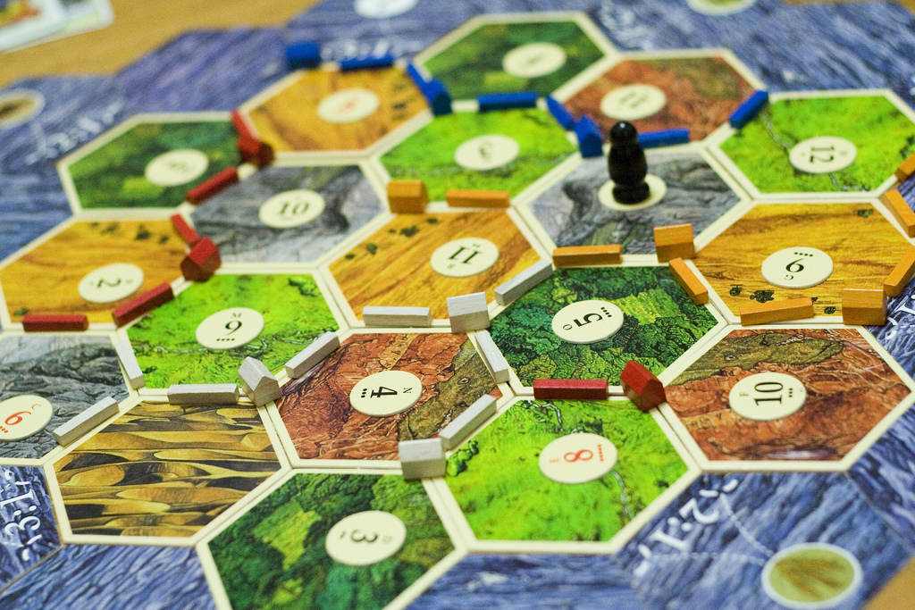
Modeling Settlers of Catan with Degrees of Freedom
Michael L Perry
Michael@qedcode.com

Slide 2



































TITANIUM SPONSORS
Platinum Sponsors
Gold Sponsors

Slide 3
Are you a gamer?
I’ve played Monopoly once
I hate fun
I’m a level 12 Dungeon Master
Dungeon Masters don’t have levels

Slide 4
Are you a mathematician?
I passed Algebra
I’m a CADET: Can’t Add, Don’t Even Try
I compute Eigenvectors in my sleep
I actually know what your session title means!

Slide 5


Slide 6
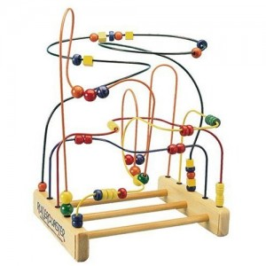

Slide 7
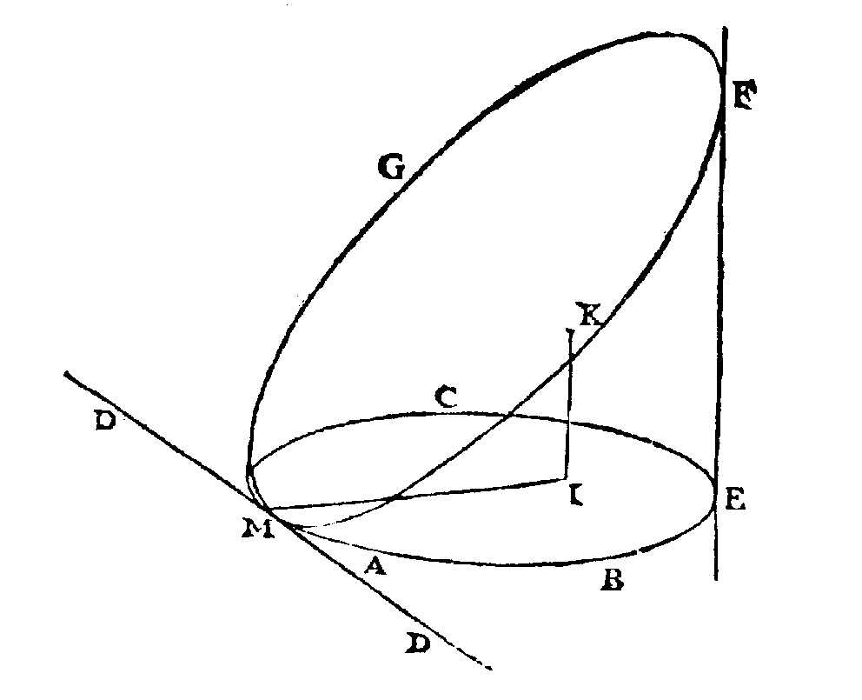

Slide 8
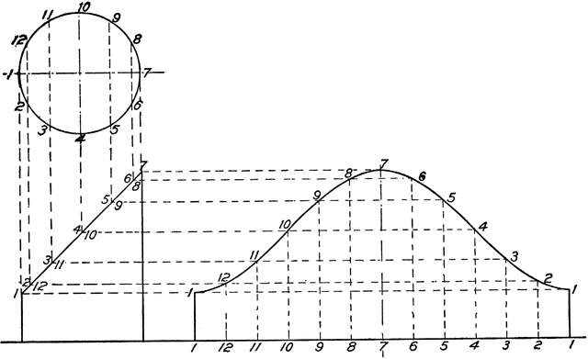


$$x^{2}+y^{2}=1$$
$$x=z$$

Slide 9



Degrees of Freedom
Number of unknowns
minus
number of equations
$$x^{2}+y^{2}=1$$
$$x, y, z$$
$$x=z$$

Slide 10






$$x^{2}+y^{2}=1$$
$$x=z$$
$$t$$
Independent
$$x=sin⁡(t)$$
$$y=cos⁡(t)$$
Dependent
$$z=sin⁡(t)$$

Slide 11
What is Independent?
public class MyClass
{
private string _thisIsIndependent;
}
public class MyClass
{
private string ThisIsToo { get; set; }
}
public class MyClass
{
// This is not.
private readonly Thing _thing;
public MyClass(Thing thing)
{
_thing = thing;
}
}

Slide 12
What is Dependent?
public class MyClass
{
private readonly Thing _thing;
public Thing(Thing thing)
{
_thing = thing;
}
// This is dependent.
public string Property
{
get => _thing.Property;
set => _thing.Property = value;
}
}

Slide 13
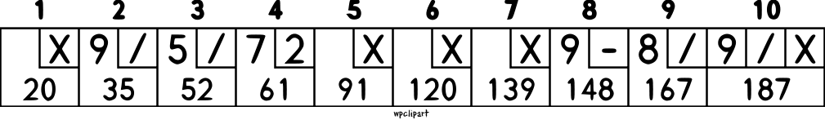

Slide 14


Slide 15
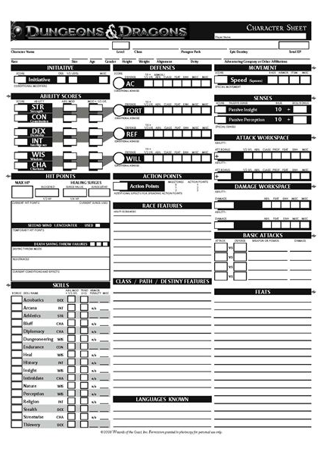

Slide 18
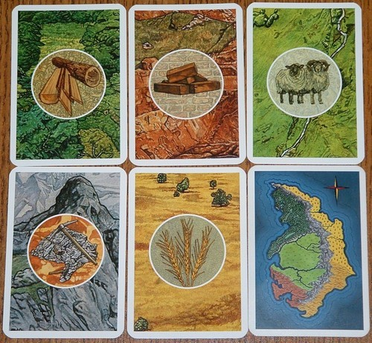
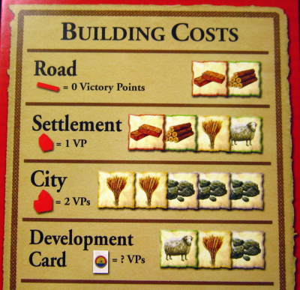

Slide 19
Degrees of Freedom
Add features without breaking existing code
Avoid the domino effect
Understand context
Preserve history

Slide 20
qedcode.com
Michael L Perry
github.com/MichaelLPerry/dof

